Slide 1
User Registration (chapter 0)
Presented by
Koustav Mukherjee

Slide 2
Content
Create a project with JSON file .
Install module for user registration.
Create usercontrolar.js file for user call and registration.
Create User.js file that consist of user schema.
Create Server.js file that consist of database file.
Create .env file that consist of MONGO_DB connection
Run a project with npm command .
Use GET and POST request using postman check status and send request to server.

Slide 3
Create a project with JSON file
Step 1- create a folder on your pc and open it using VS Code or Code editor
Step 2- Go to Vs code terminal manu and select New terminal option
Step 3 – use ‘npm init’ command for initialization the project .
Gave the project name authour name all thouse thing and then save the project using ‘y’.
After that create a JSON file on vs code

Slide 4
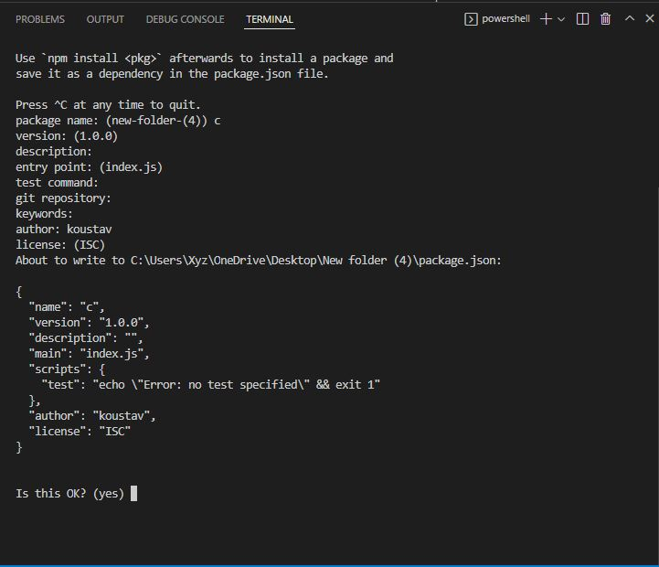

Slide 5
Install node module
After the project create we install the node module with help of npm (Node Package Manager)
For instal go to tarminal and use npm Install <pacakege name> or use npm i<package name>

Slide 6
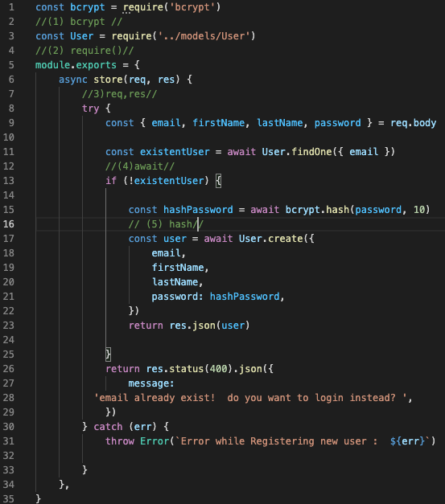
Create usercontrolar.js file

Slide 7
usercontrolar.js file
1.bcrypt:- bcrypt is a node package that use for build a password security that scales with a computation power . For install bcrypt we use npm install bcrypt
2. requre :- requre is a spacel type of function that built in for load modules for different programming languages.
3. req(request)/res(response):- req is an object connecting http request that raised the event and res is atype of response that send back the desier http response.

Slide 8
usercontrolar.js file
4.Await:- await is a type of promises that used by operator. It can used by ‘async’ function within the js code or own js modules.
5.hash :- hash is a type of function that use for arbitory size data input and produces an out of fixed size data
6. create :- create is a method that use for construct a user model that used in database.

Slide 9
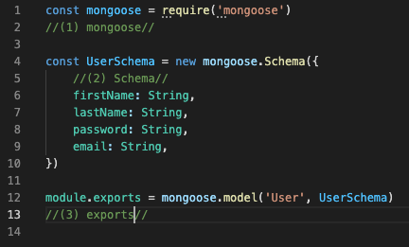
Create User.js file

Slide 10
Create User.js file
1. constract mongoose using requre function
2 mongoose:- mongoose is a node package that use for object data modeling library for mongo DB database . Its managed the relationship between data and provides schema validtion . It also use for translate the object data between mongoDB and user .

Slide 11
Create User.js file
3. Schema :- Schema is a data blueprint that collection of information that available on our environment.
4. exports:- The module exports in Node.js is used to export any literal, function or object as a module. It is used to include JavaScript file into node.js applications. The module is similar to variable that is used to represent the current module and exports is an object that is exposed as a module.

Slide 12
Create Server.js file
1.express:- Express.js is a web application framework for Node.js. It provides various features that make web application development fast and easy which otherwise takes more time using only Node.js. Express.js is based on the Node.js middleware module called connect which in turn uses http module. So, any middleware which is based on connect will also work with Express.js.

Slide 13
Create Server.js file
2 CORS:- cors is a node. js package for providing a Connect/Express middleware that can be used to enable CORS with various options.
3. .env :- .env is a costomize working enviroment variable and it is a hidden file .and it also use to connect the database .
4. Config:- config use for configure our application for using hard coded value or a JSON objects. That embladed iside an html or XML document.

Slide 14
Create Server.js file
5.useNewUrlParser:true – this is added to allow user to fall back the old parser and find out the bug in a new perser.
useUnifiedTopology:true- it is use for true mongoDB driver is a new connection management engine.
6 Get :- it is used for running a spacific element among all the element which r present.

Slide 15
Create Server.js file
7.Post:- post is an http request that use for submit the achynchronous request from the server without reloading the pages.
8. lesten :- it is used for listen the request for the spacific host or port.

Slide 16
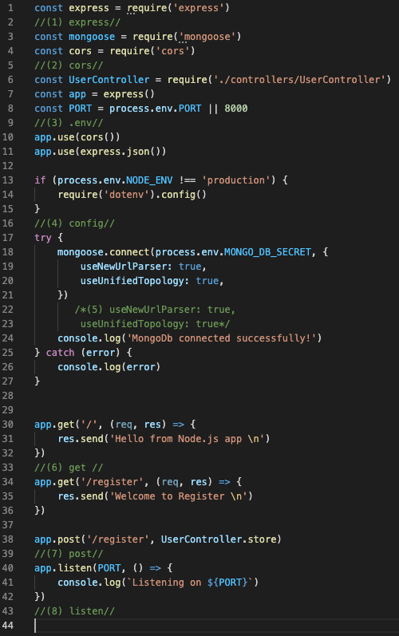
Create Server.js file

Slide 17
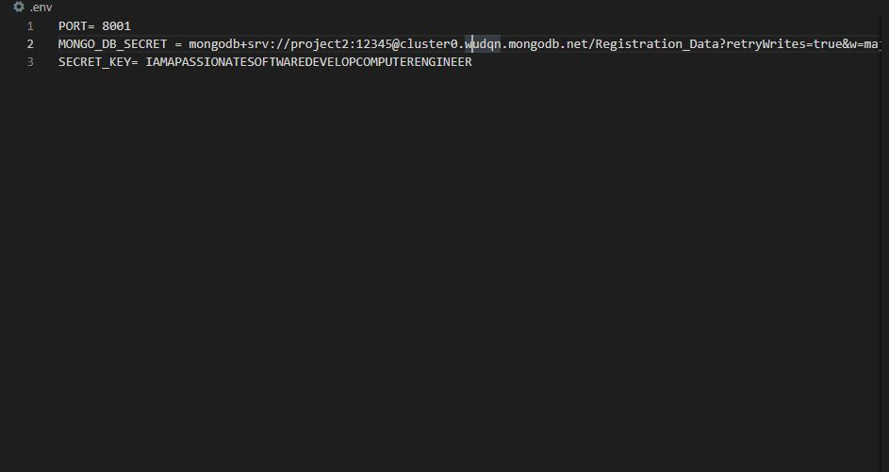
Create .env file that consist of MONGO_DB connection

Slide 18
Run the project
After completing the js file code we run the project using npm
Stap1 – Go to terminal and use npm start for start the server, Or other we are use NODEMON package for start the server
For nodemon install using npm i< nodemon>
Then configer the JSON file nodemon : start <start point>
Go to consol and npm start

Slide 19

Config of nodemon in JSON

Slide 20
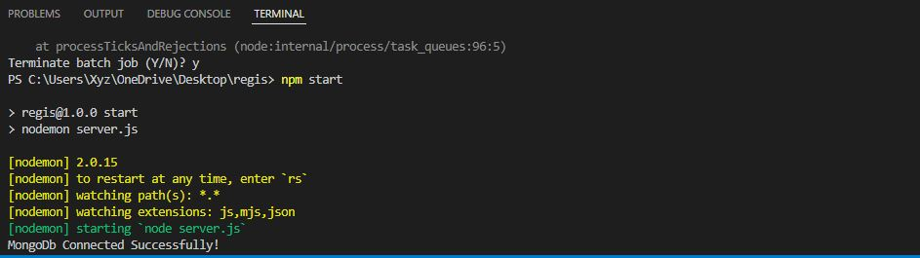
Connection result

Slide 21
Use GET and POST request using postman
Postman:- It is a software testing tool to test APIs. With this we can create, test, share and document APIs. It is a simple Graphic User Interface for sending and viewing HTTP requests and responses. It is used for backend testing where we enter the end-point URL, it sends the request for the server and receives the response back from server.

Slide 22
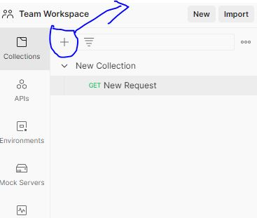
How we use postman
Step 1:- Go to the callection tab click on the ‘+’ button create a new collection it will appear name or other satting .

Slide 23
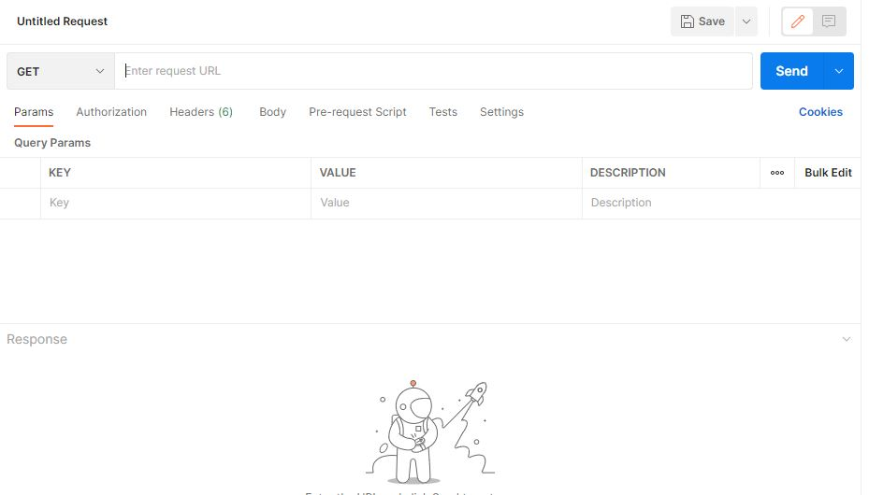
How we use postman
Step 2:- then select create a new request and it will open an window on post man application

Slide 24
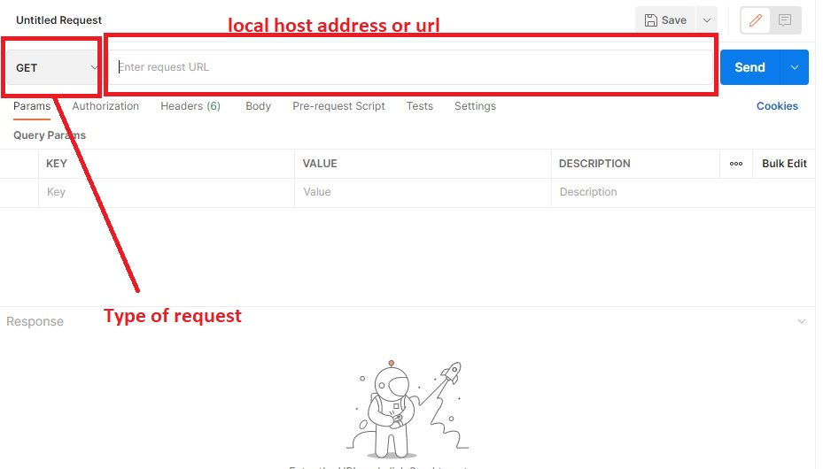
How we use postman
Step 3 :- set the address of your local host and add the request type get and chack the result

Slide 25
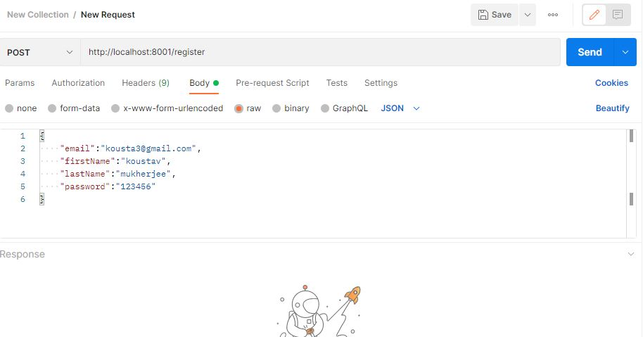
How we use postman
Step 4 - Set post request and put the value and check the status if it show 200 then its ok or if show 404 then error is process

Slide 26
Thank You

